Slide 1

Design and Analysis of Algorithms
Instructor: Muhammad Arif Shah

Slide 2
Lecture No. 03
Analysis of 2-Dimensional Maxima

Slide 3
Analysis of 2-Dimensional Maxima
MAXIMA(int n, Point P[1….n])
for i 1 to n
do maximal true
for j 1 to n
do
if(i≠ j) and (P[i].x ≤ p[j].x) and (P[i].y ≤ p[j].y)
then maximal false; break
if (maximal = true)
then output P[i].x, P[i].y
Analysis of Algorithms should lead us to more critical thinking
Can we devise an algorithm that takes time less than n²

Slide 4
Examples
Devising a Better Algorithm
In Brute-Force Algorithm
  We compare every point with all other points.
  If we look a bit deep into the problem, you would know that comparing this way is not necessary.
The brut-force algorithm uses no intelligence in pruning out decisions
For example, once we know that a point p_{i} is dominated by another point p_{j}, then we do not need to use p_{i} for eliminating other points
This follows from the fact that Dominance relation is transitive
  If p_{j} dominates p_{i} and p_{i} dominates p_{h} then p_{j} also dominates p_{h}; p_{i} is not needed.
For example, p3 is dominated by p4. So no need to use p3 for removing other points. It means p3 can not be in maximal set

Slide 5
Examples
Plane-Sweep Algorithm
We will sweep a vertical line across the 2-dimensional plane from left-to-right
As we sweep, we will build a structure holding the maximal points lying to the left of the sweep line
When the sweep line reaches the rightmost point of P, we will have the complete set of maximal points
This approach of solving geometric problems is called the plane sweep.
The processing order of points!
Sort the points in increasing order with respect to x values
For this purpose, we employ a fast sorting algorithm

Slide 6
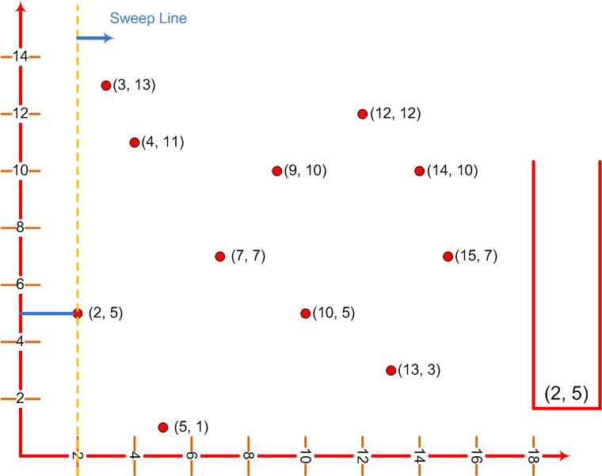
Examples
Plane-Sweep Algorithm
Stack

Slide 7
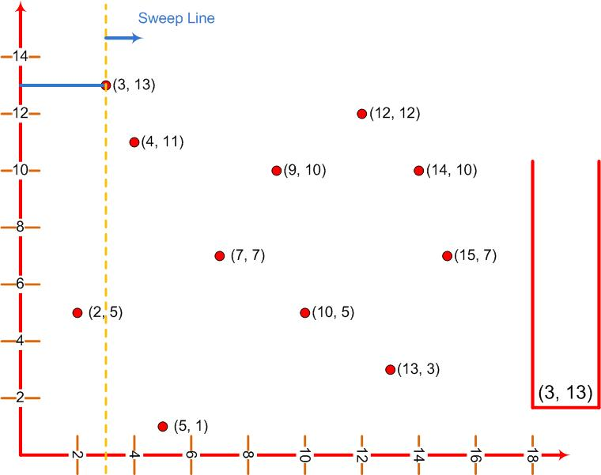
Examples
Plane-Sweep Algorithm
Stack

Slide 8
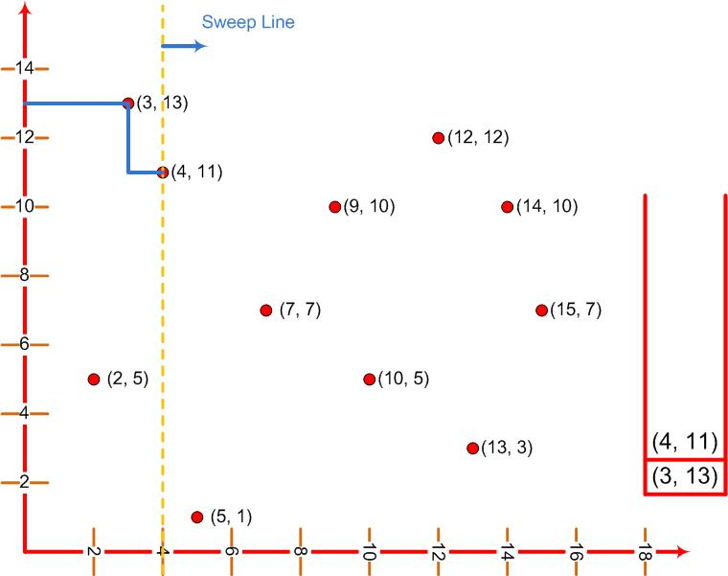
Examples
Plane-Sweep Algorithm
Stack

Slide 9
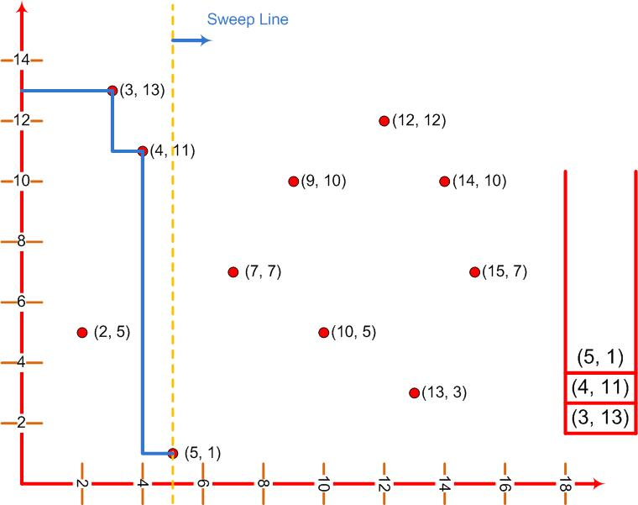
Examples
Plane-Sweep Algorithm
Stack

Slide 10
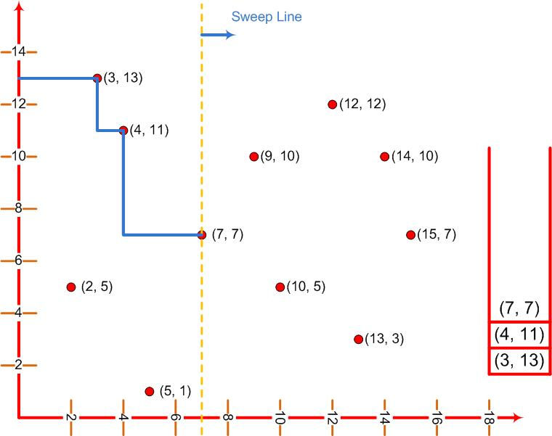
Examples
Plane-Sweep Algorithm
Stack

Slide 11
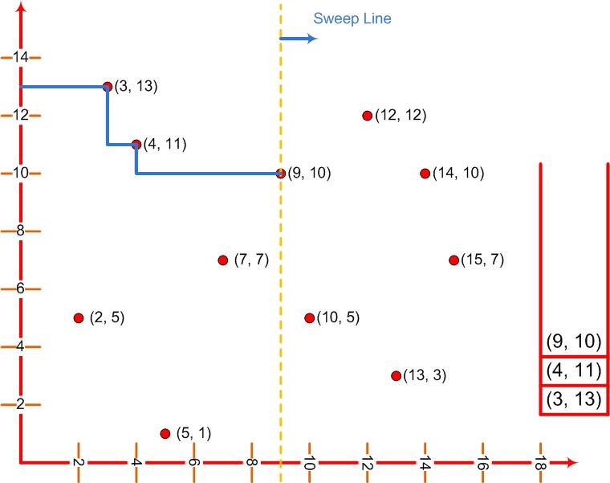
Examples
Plane-Sweep Algorithm
Stack

Slide 12
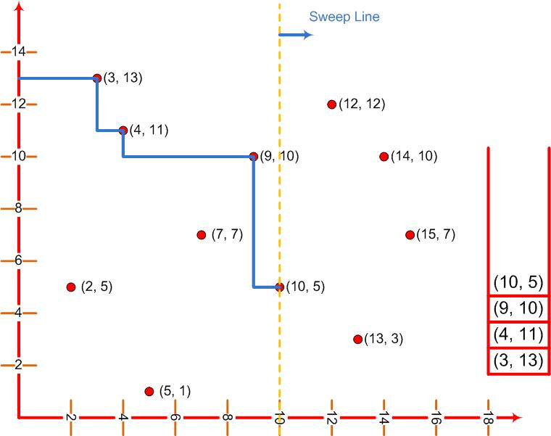
Examples
Plane-Sweep Algorithm
Stack

Slide 13
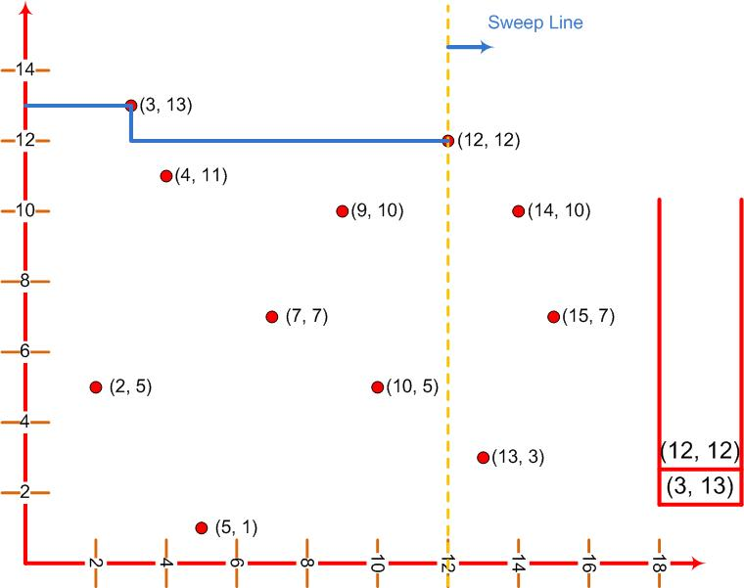
Examples
Plane-Sweep Algorithm
Stack

Slide 14
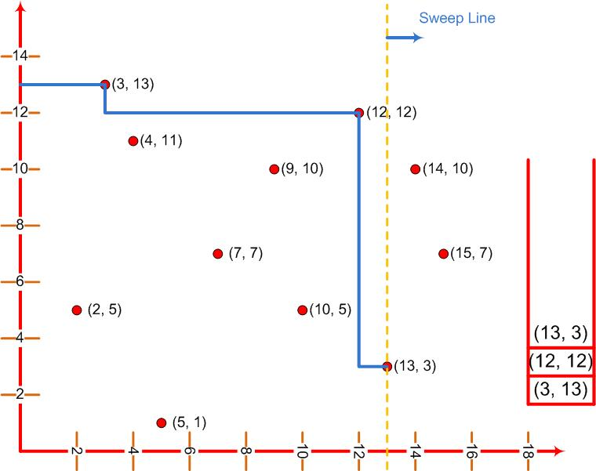
Examples
Plane-Sweep Algorithm
Stack

Slide 15
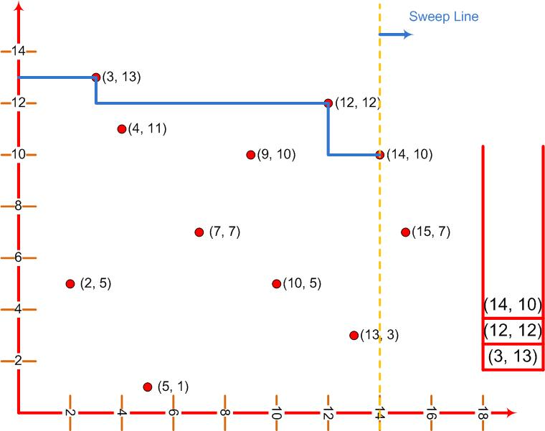
Examples
Plane-Sweep Algorithm
Stack

Slide 16
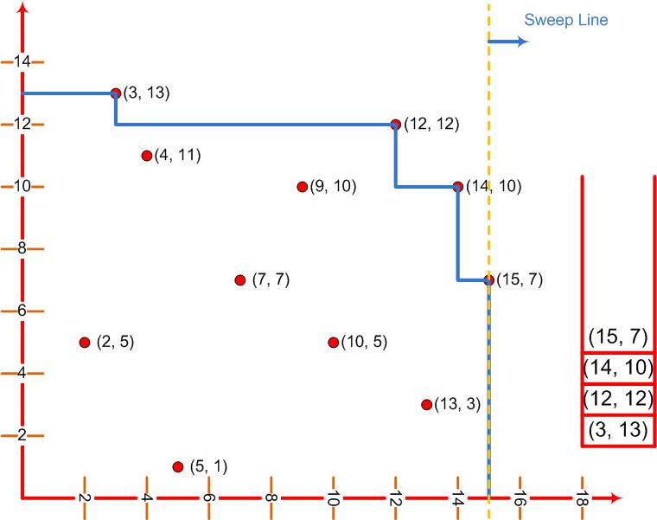
Examples
Plane-Sweep Algorithm
Stack

Slide 17
Examples
Plane-Sweep Algorithm
How we got this idea?
How we come to this conclusion that we should use this vertical sweep line.
The answer is really difficult, but straight forward.
We have to practice a lot seeing at others’ examples

Slide 18
Examples
Plane-Sweep Algorithm
PLANE-SWEEP-MAXIMA(n, P[1…n])
Sort P in increasing order by x
stack s;
for i 1 to n
do
while (s.notEmpty() & s.top().y ≤ P[i].y)
do s.pop();
s.push (P[i]);
Output the contents of stack s;

Slide 19

Examples
Plane-Sweep Algorithm
Sorting takes Θ(n²)
The for loop executes n times
The inner loop could be iterated (n-1) times
It seems that we still have n(n-1) or Θ(n²) algorithm

Slide 20
Examples
Plane-Sweep Algorithm
We pop an element off the stack each time we go through the inner while-loop
It is impossible to pop more elements than are ever pushed on the stack
Therefore, the inner while-loop cannot execute more than n times over the entire course of the algorithm

